Slide 1
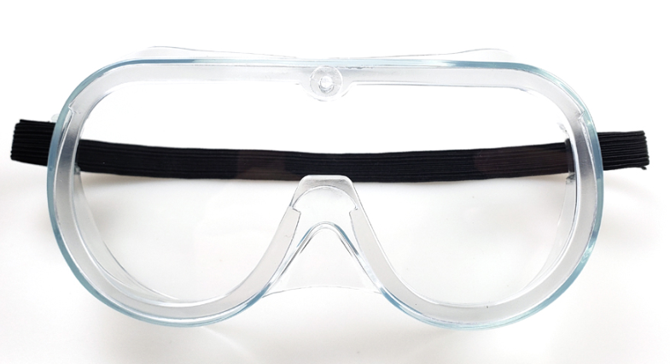
LB-01 Protective Goggles
Vision Area size
150mm
70mm

Slide 2
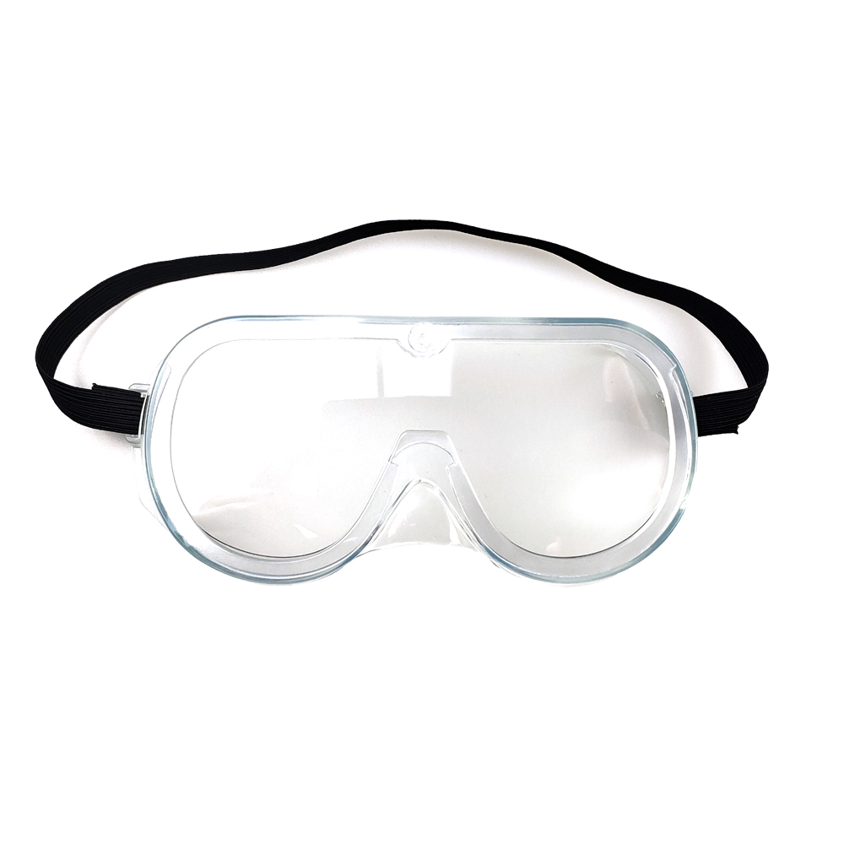
NOTE: To complete the world demanding volume for protective goggles by running the MAX capacity per day, the PO shipped maybe assorted by 3 models listed in this profile(LB-01/02/03) without sending only one model .
备注：为了满足疫情时期的巨大需求，让产能最大化运作， 3种款式可能随机出货来达到订单总数量，不建议选定款式。

Slide 3
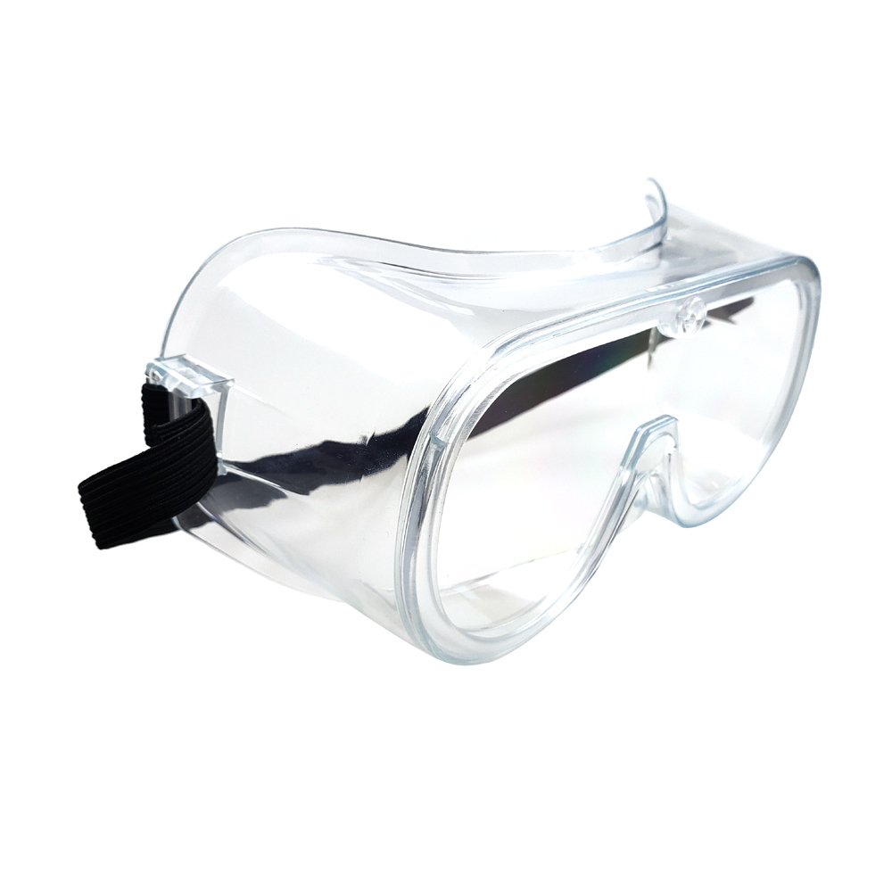
PVC soft frame
PC(polycarbonate)
Antifog coating
Impact Resistant
Adjustable Strap-comfortable fit

Slide 4
SPECIFICATIONS (LB-01/02/03)
Size: Medium (Adult)
Weight: 75g/pc
Frame: PVC, clear
Lens: Polycarbonate(PC), clear
Adjustable strap, black
Treatment: Antifog
Certifications: CE/EN166
Usage: Splash Impact,laboratory, industrial, workers

Slide 5
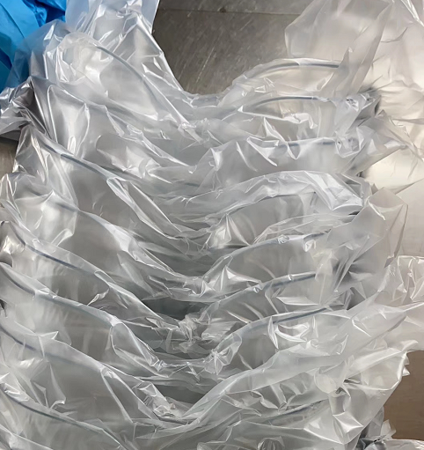
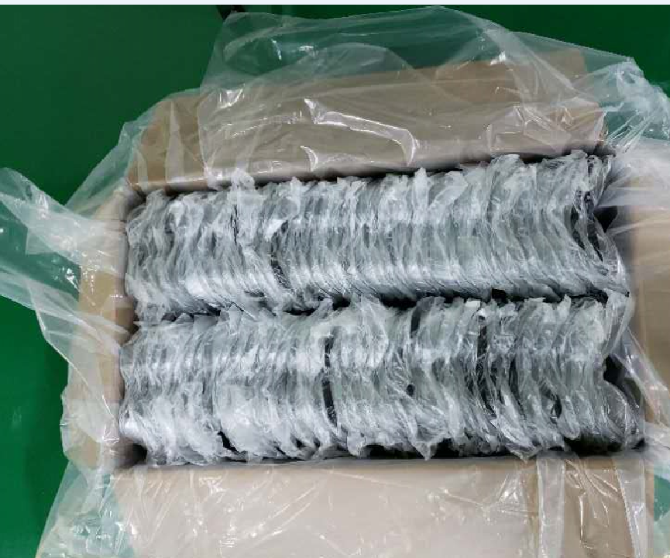
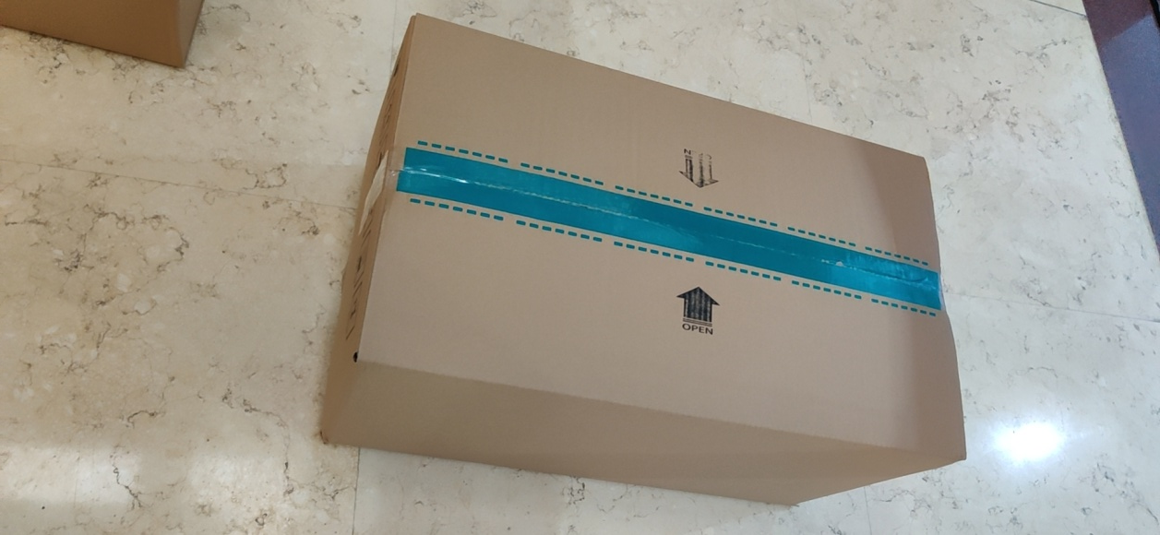
Package: polybag/Carton
包装方式: 塑料袋、纸箱

Slide 6
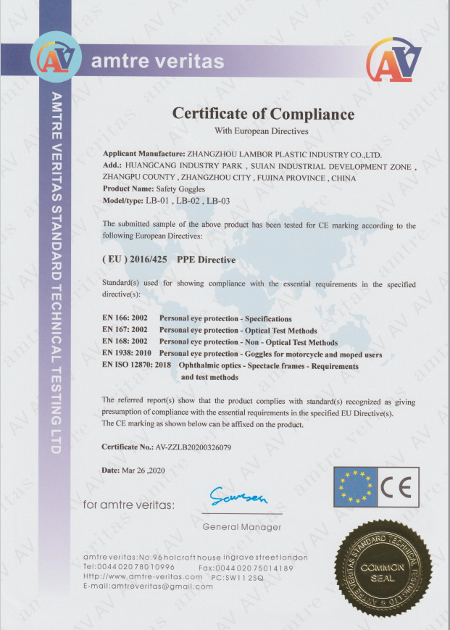
CE CERTIFICATION

